Slide 1


MALICIOUS URL DETECTION USING MACHINE LEARNING

Slide 2


MAJOR PROJECT
TEAM-38
CHIDURALA ASHWINI (2103A52028)
TAKKARSU SAI PRIYA (2103A52110)
KORUKANTI MADHUSRI (2103A52090)
KATHA SRAVANI (2103A52085)
Under the Guidance of
MR. N MAHENDER
Assistant Professor School of Computer Science and
Artificial Intelligence, SR University

Slide 3
ABSTRACT
Malicious URL detection is a critical aspect of cybersecurity aimed at protecting users from phishing attacks, malware, and other online threats. This project leverages machine learning techniques to build a robust system capable of identifying and classifying URLs as malicious or benign. By analyzing various features of URLs, such as length, structure, domain information, and special character usage, machine learning models learn patterns commonly associated with harmful websites. Algorithms like LightGBM
, XGBoost , Gradient Boosting, and Random Forest are employed to enhance detection accuracy and efficiency. Through data preprocessing, feature extraction, and model training, our approach ensures a high-performance system for real-time malicious URL detection. This work provides a scalable and automated solution to strengthen online security and mitigate the risks associated with malicious URLs.

Slide 4
INTRODUCTION
As the internet becomes essential for personal, business, and government activities, malicious URLs pose a growing cybersecurity threat, often used in phishing and malware attacks. Detecting and blocking these harmful URLs in real-time is crucial to protect users and prevent damage.
Traditional signature-based methods struggle with new threats, but machine learning offers a promising solution. This project aims to build a system that classifies URLs as malicious or benign by analyzing their features, such as structure, domain, and special characters. Using advanced machine learning models like LightGBM, XGBoost, and Random Forest, the project focuses on enhancing detection accuracy and efficiency. The goal is to develop a robust, automated system for real-time malicious URL detection to improve online security.

Slide 5
MOTIVATION
We are doing this project to protect people from online scams and cyberattacks. Nowadays, hackers send fake links, malware, and phishing websites to steal personal information and money. Many users don’t know which links are safe and which are dangerous.
Nowadays, everyone is using social media and digital transactions. Hackers are stealing personal information and money by sending unknown links, malware, and fake websites. Many people fall for these tricks and lose their data or money.
Machine learning can help detect these harmful links quickly and stop cyberattacks. This makes online browsing and transactions safer for everyone

Slide 6
PROBLEM STATEMENT
Traditional methods of detecting harmful URLs are slow and not very effective because attacks are getting more advanced. Checking URLs manually is impossible due to the huge number of websites.
while existing automated systems often lack accuracy. The challenge is to develop a scalable, machine-learning-based solution that efficiently analyzes URL features (such as length, structure, and domain information) to provide accurate, real-time threat detection without compromising performance or generating too many false positives.

Slide 7
OBJECTIVE OF THE PROJECT
The main objective of this project is to develop a machine learning-based system for detecting malicious URLs to enhance online security.
Analyze URL features (such as length, structure, and domain) to identify threats.
Provide real-time detection to protect users from cyberattacks.
Reduce false positives to avoid blocking safe websites.

Slide 8
EXISTING METHOD VERSUS PROPOSED METHOD
Existing systems rely on blacklists or rule-based detection methods, which only work for known malicious URLs.
These systems use static pattern matching and require frequent manual updates, making them slow and prone to missing new threats.
They have limited accuracy (around 70-80%) and a high rate of false positives.
Our proposed method uses machine learning algorithms (LightGBM, XGBoost, and Random Forest) to automatically analyze and classify URLs.
It extracts and evaluates various URL features dynamically, enabling real-time detection with adaptive learning.
The system achieves better accuracy (>90%), reduces false positives, and can detect new and unknown threats efficiently without manual intervention.

Slide 9
GAPS IDENTIFIED
inability to Detect New Threats :Blacklist-based and rule-based methods fail to identify newly created malicious URLs.
High False Positives & False Negatives :Existing systems often block safe websites or allow harmful ones due to outdated detection rules.
Limited Feature Analysis : Most methods only rely on basic URL checks rather than advanced feature extraction.

Slide 10
LITERATURE REVIEW
SNO | PaperTitle | Authors | Model used | Demerits | Future scope
1 | Comparative Evaluation of Machine Learning Models for Malicious URL Detection | Mankar,Nikhilesh P and Sakunda, Prashant E and Zurange, Sachin and Date, Anup and Borate, Vishal and Mali, Yogesh Kisan | Random Forest Decision Tree KNN AdaBoost | it misses possible strategies for addressing class imbalance, provides insufficient information on feature selection. | Future studies may concentrate on tackling class imbalance by utilizing sophisticated methods such as resampling or cost-sensitive learning.
2 | Detecting malicious URLs using machine learning techniques | Vanhoenshoven, Frank and N{\'a}poles, Gonzalo and Falcon, Rafael and Vanhoof, Koen and K{\"o}ppen, Mario | Decision trees, Bayesian networks, K-nearest neighbor, Support vector Multi-layer perceptron, Random forest. | it highlights the possible dangers of overfitting, is missing a conversation about model interpretability, and does not consider how the approaches would fare with more varied or real-world data. | Future research may investigate the use of sophisticated feature selection methods, deep learning algorithms, and practical datasets to strengthen model resilience and further boost classification precision for identifying malicious URLs.

Slide 11
SNO | Paper Title | Authors | Model used | Demerits | Future scope
3 | A malicious URLs detection system using optimization and machine learning classifiers | Lee$^1$, Ong Vienna and Heryanto, Ahmad and Ab Razak, Mohd Faizal and Raffei, Anis Farihan Mat and Phon, Danakorn Nincarean Eh and Kasim, Shahreen and Sutikno, Tole. | Random Forest, AdaBoost, Naive Bayes, svm, knn. | The information provided is missing specifics regarding the optimization methods employed, does not tackle the issue of potential overfitting,. | It might aim to improve the strategy by applying it to larger and more varied datasets, integrating sophisticated feature selection techniques.
4 | Malicious URL Detection and Classification Analysis using Machine Learning Models | DR, Upendra Shetty and Patil, Anusha and others | LightGBM, XGBoost Random Forest | fails to explore strategies for managing model overfitting, does not consider the scalability of the method, and omits information on the model's performance previously unseen or evolving malicious URLs. | They might concentrate on boosting the model's ability to adjust to emerging and changing threats, improving its real-time detection features, and investigating the possibility of integrating with additional security systems.

Slide 12
5 | Towards the detection of malicious URL and domain names using machine learning | Ghalati, Nastaran Farhadi and Ghalaty, Nahid Farhady and Barata, Jos{\'e} | Random Forest Linear Regression Naive Bayes. | The method suggests that depending only on fixed lexical characteristics and N-grams. | The next steps for this project involve conducting a deeper analysis of how separating domain names and URLs impacts performance,.
6 | Comparitive analysis of machine learning algorithms on malicious URL prediction | Vaishnavi, D and Suwetha, S and Jinila, Y Bevish and Subhashini, R and Shyry, S Prayla | Logistic Regression Decision tree | The potential difficulties of the selected models in practical applications have not been addressed. | In the future, additional factors may also be taken into account for analysis, which could enhance the accuracy even more.
7 | An Automated System to Detect Phishing URL by Using Machine Learning Algorithm | Parasar, Deepa and Jadhav, Yogesh H. | Support Vector Machine, Naive Bayes Logistic Regression | fails to consider potential difficulties in practical implementation, including the flexibility of the models or concerns regarding data quality. | Future studies might concentrate on strengthening model resilience through the incorporation of more sophisticated characteristics.

Slide 13

DATASET AND ITS DESCRIPTION
The dataset contains 651,191 entries with 2 columns. dataset was prepared by collecting urls across google and Kaggle.
URL :The web address to be classified.
Type : The label indicating the category of the URL, which can be : benign, defacement, malware, phishing.

Slide 14
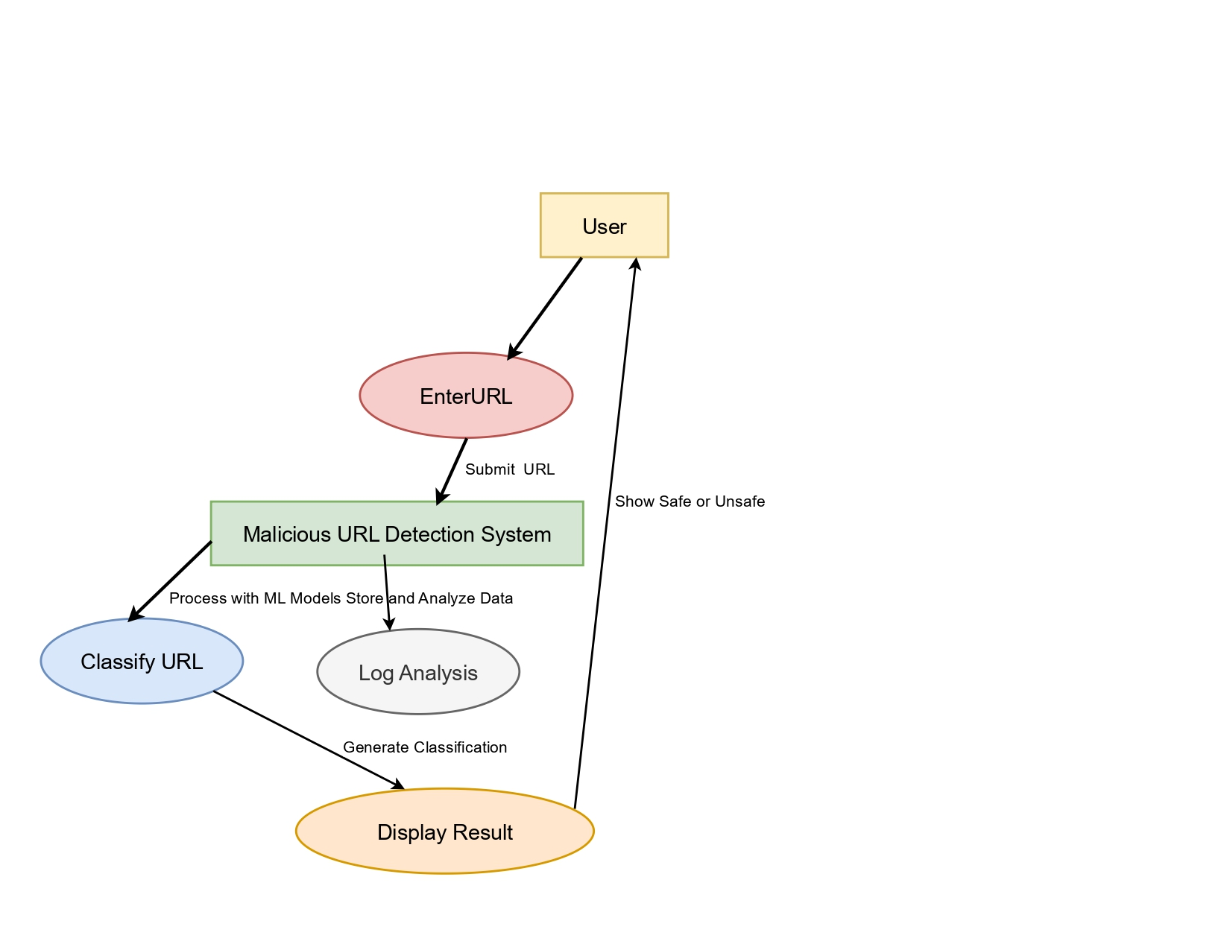
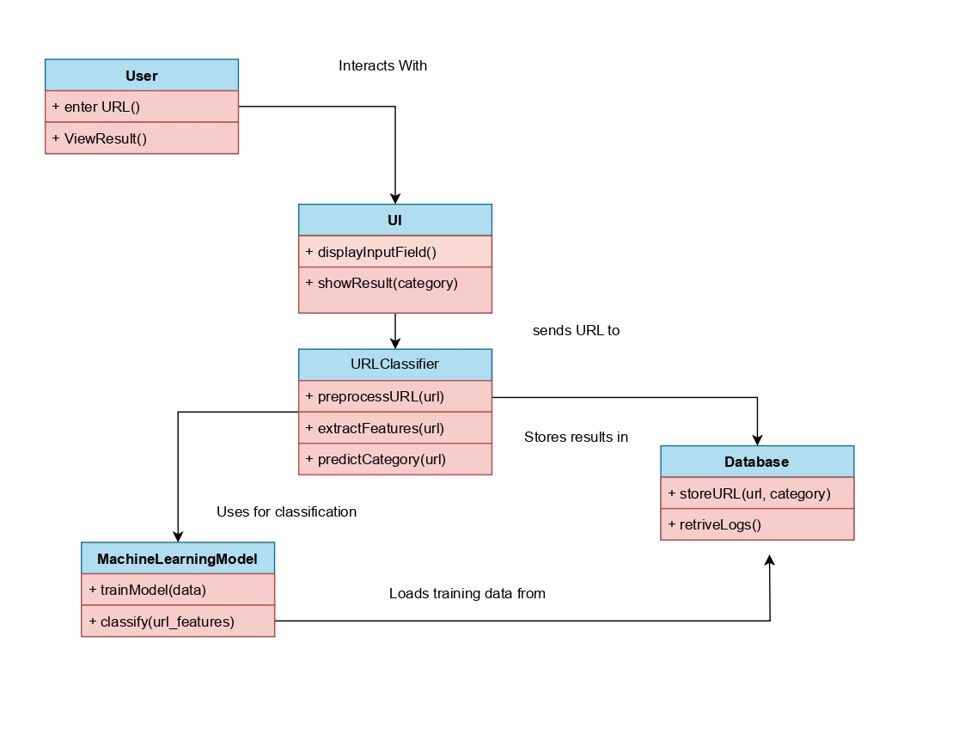
UML DIAGRAMS
Fig : class diagram
Fig : use case diagram

Slide 15
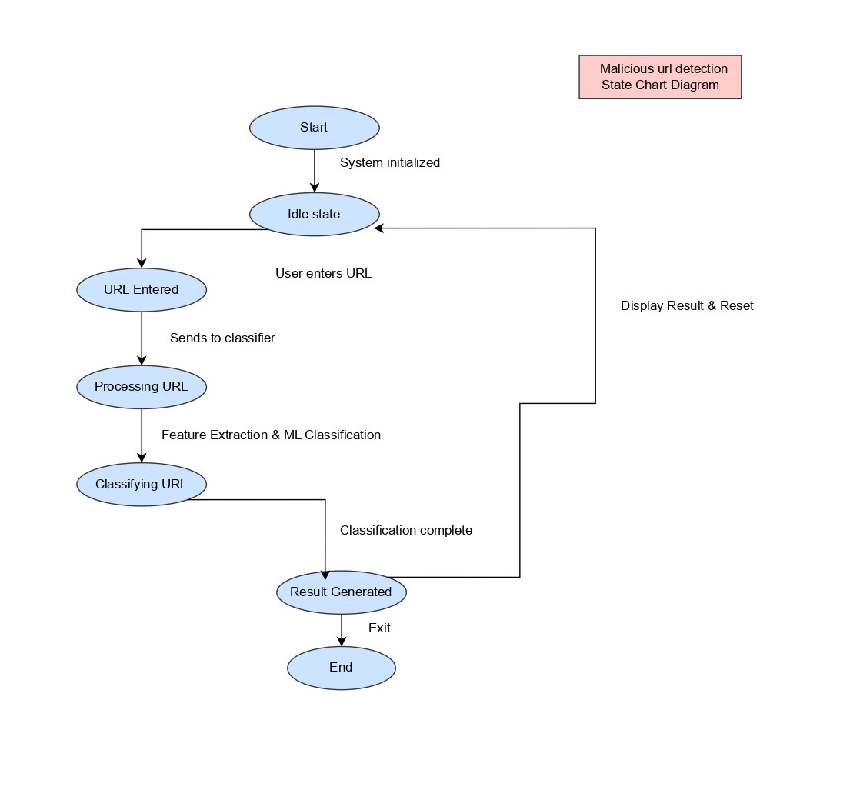
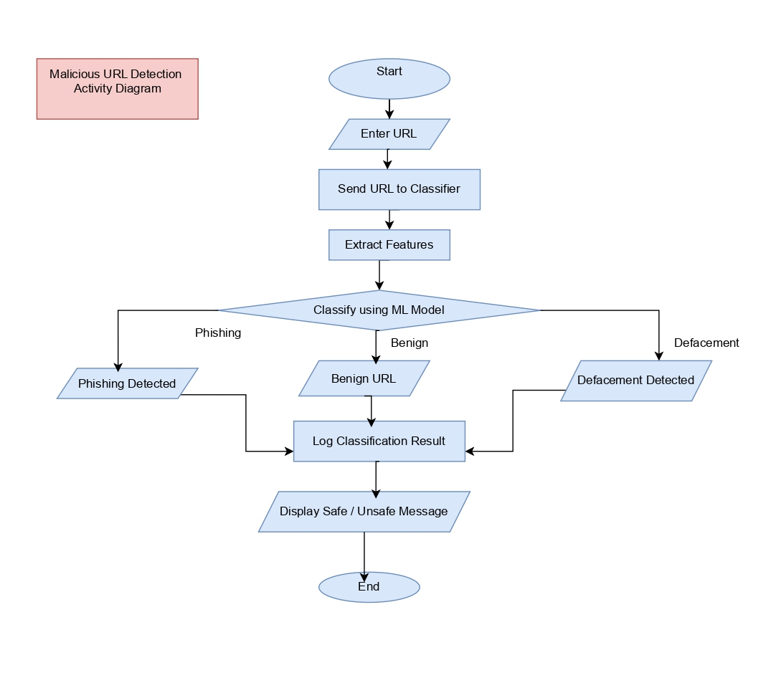
Fig: state chart diagram
Fig: Activity diagram

Slide 16
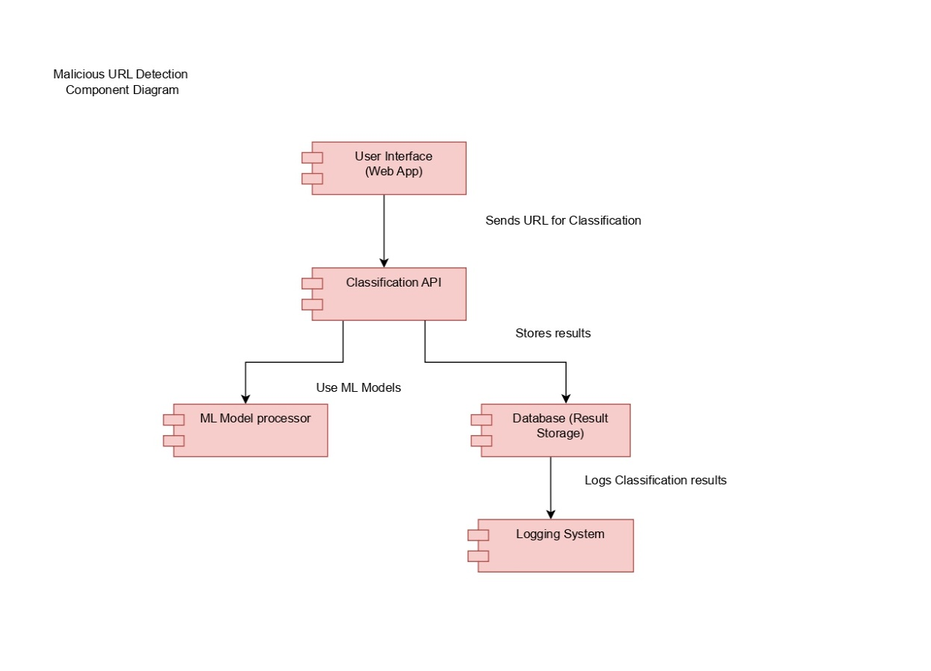
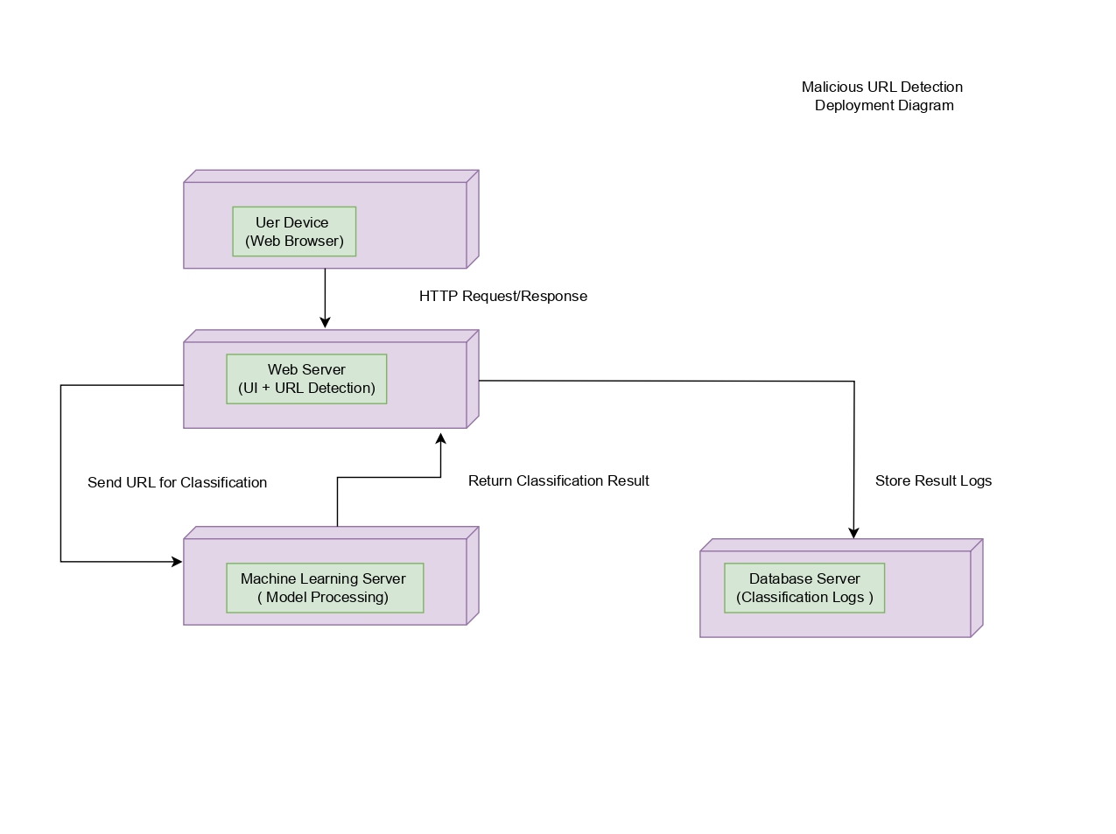
Fig: Component diagram
Fig: Deployment diagram

Slide 17
METHODOLOGY
Input: URL
Preprocessing the data
Extract features
Training the model
Random forest
XG Boost
ML models
Light GBM
classify url
Benign, defacement, phishing, malware
Result
Safe / malicious
Fig: methodology / model architecture

Slide 18
ALGORITHAMS USED
XGBoost (Extreme Gradient Boosting):
An algorithm known as boosting constructs decision trees in a sequential fashion, with each tree fixing the errors of the one before it.
Gradient boosting is used to increase accuracy and reduce errors.
It is effective for big datasets and performs well with tabular data.
Random forest:
A bagging algorithm that generates several decision trees and uses the majority vote for classification is Random Forest.
When compared to a single decision tree, it helps lessen overfitting.
It works well with multi-featured structured data.

Slide 19
3. LightGBM:
The Light Gradient Boosting Machine, or LightGBM an additional boosting algorithm that has been streamlined for efficiency and speed.
Trees are grown leaf-wise rather than level-wise, which saves memory and speeds up the process.
It works well with big datasets that contain high-dimensional features.
4. AdaBoost (Adaptive Boosting):
A boosting technique that combines multiple weak classifiers, giving more focus to misclassified instances in each iteration.
It is simple and effective but may be sensitive to noisy data.

Slide 20

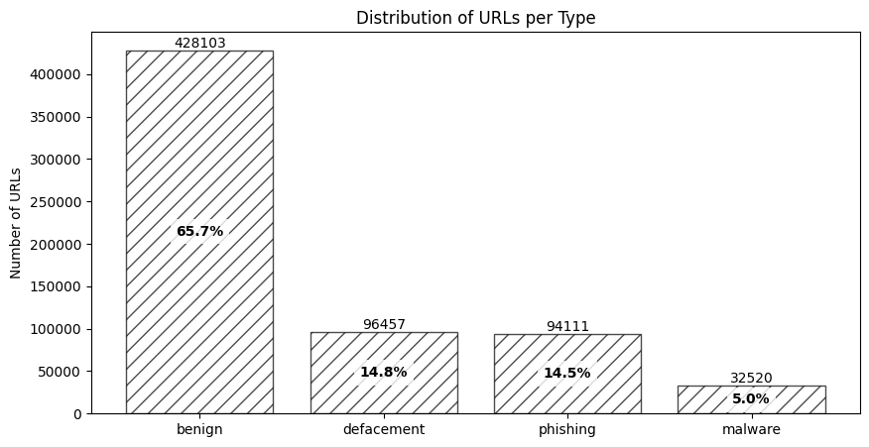
Fig: bar chart for types of Url’s distribution

Slide 21
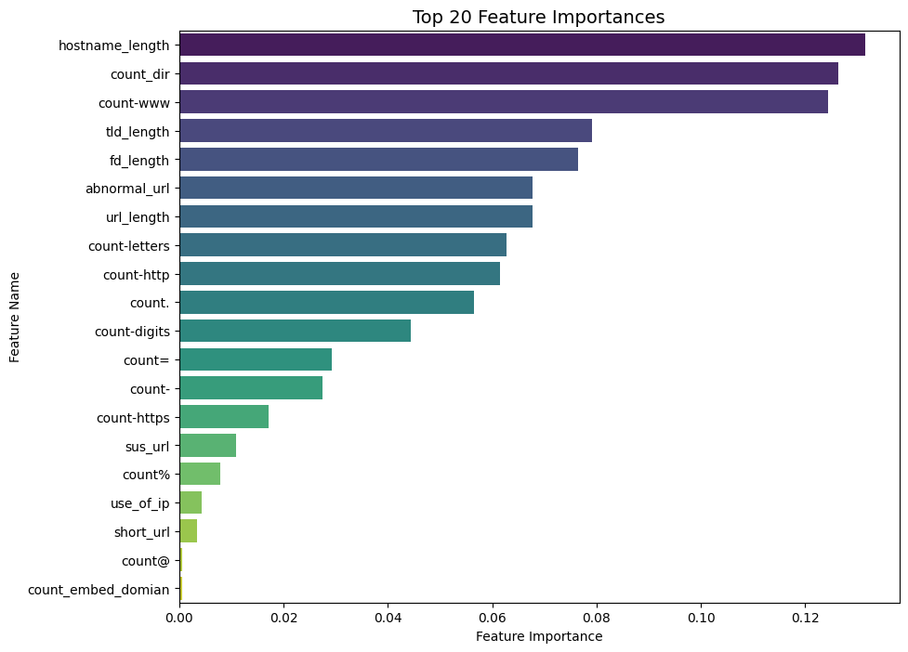
Fig: Top 20 important features

Slide 22
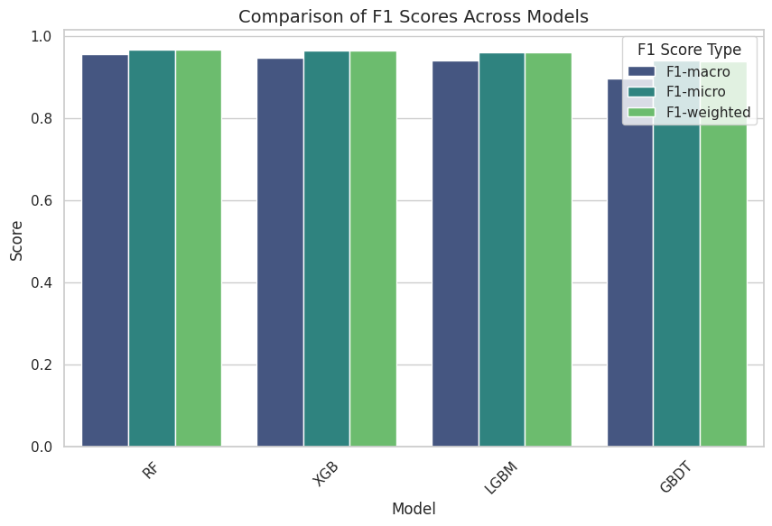
Fig: comparision of model performances using F1 scores

Slide 23
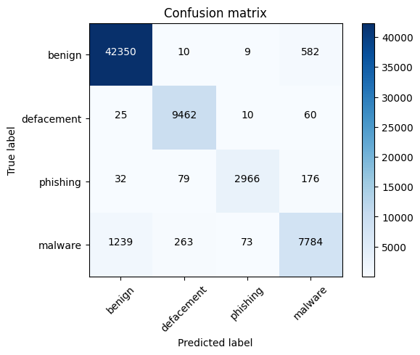
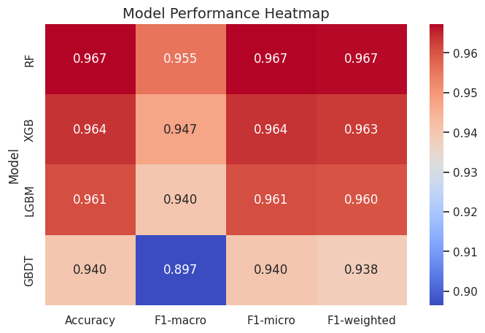
Fig: confusion matrix
Fig: Heatmap for model performance

Slide 24
Model | Accuracy | F1-macro | F1-micro | F1-weighted
RF | 0.967260 | 0.955395 | 0.967260 | 0.966905
XGB | 0.963729 | 0.947367 | 0.963729 | 0.963042
LGBM | 0.960719 | 0.940433 | 0.960719 | 0.960017
GBDT | 0.940433 | 0.896504 | 0.940433 | 0.938472
Highest accuracy: 0.967
Table: different model performances

Slide 25
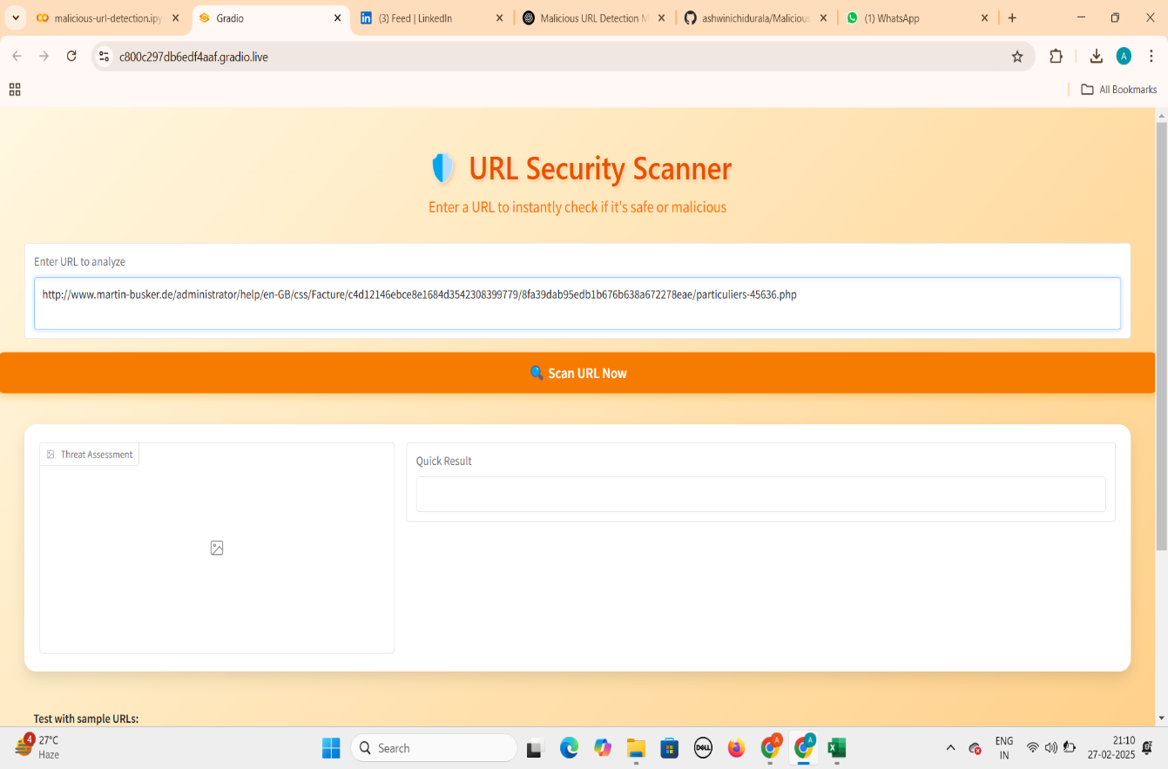
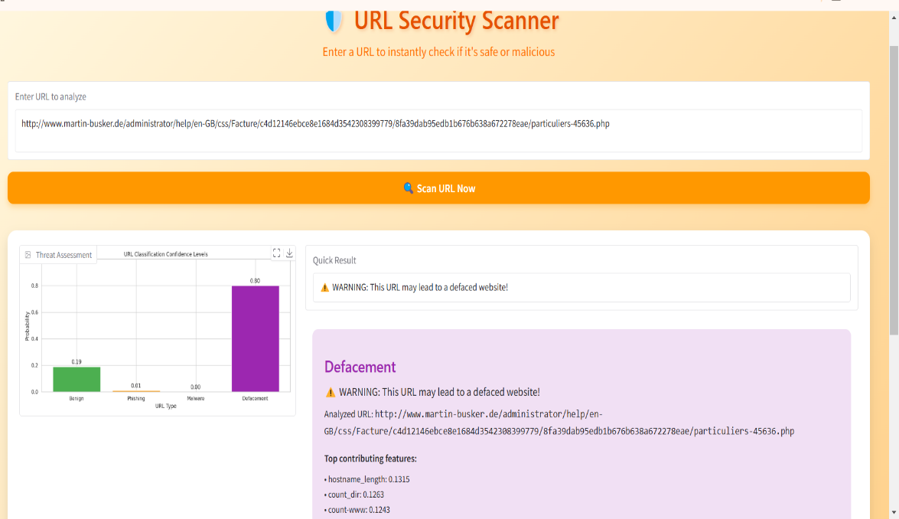
USER INTERFACE
Fig: user interface: entering url for malicious detection and classification
Fig: user interface classification report

Slide 26

CONCLUSION : In this project, we implemented and evaluated multiple machine learning models Random Forest (RF), XGBoost (XGB), LightGBM (LGBM), and Gradient Boosting ,to detect malicious URLs. The evaluation was based on accuracy, F1-macro, F1-micro, and F1-weighted scores .Random Forest achieved the highest accuracy (96.73%) and best overall performance, making it the most effective model for detecting malicious URLs. Overall, ensemble learning models (such as RF and XGB) proved to be highly effective in detecting malicious URLs, demonstrating that combining multiple decision trees leads to better generalization and robustness.
FUTURE SCOPE : Using Natural Language Processing (NLP) techniques to analyze URL text structure and identify phishing patterns. Implementing online learning techniques to continuously adapt to new malicious URL patterns. Using automated retraining pipelines to keep models up-to-date with the latest threats. By incorporating these advancements, we can further enhance the accuracy, efficiency, and robustness of malicious URL detection systems, making them more reliable for cybersecurity applications.

Slide 27
REFERENCES
Mankar, N. P., Sakunde, P. E., Zurange, S., Date, A., Borate, V., & Mali, Y. K. (2024, April). Comparative Evaluation of Machine Learning Models for Malicious URL Detection. In 2024 MIT Art, Design and Technology School of Computing International Conference (MITADTSoCiCon) (pp. 1-7). IEEE.
Vanhoenshoven, F., Nápoles, G., Falcon, R., Vanhoof, K., & Köppen, M. (2016, December). Detecting malicious URLs using machine learning techniques. In 2016 IEEE Symposium Series on Computational Intelligence (SSCI) (pp. 1-8). IEEE.
Lee¹, O. V., Heryanto, A., Ab Razak, M. F., Raffei, A. F. M., Phon, D. N. E., Kasim, S., & Sutikno, T. (2020). A malicious URLs detection system using optimization and machine learning classifiers. Indonesian Journal of Electrical Engineering and Computer Science, 17(3), 1210-1214.
DR, U. S., & Patil, A. (2023, January). Malicious url detection and classification analysis using machine learning models. In 2023 International Conference on Intelligent Data Communication Technologies and Internet of Things (IDCIoT) (pp. 470-476). IEEE.
Ghalati, N. F., Ghalaty, N. F., & Barata, J. (2020, April). Towards the detection of malicious URL and domain names using machine learning. In Doctoral Conference on Computing, Electrical and Industrial Systems (pp. 109-117). Cham: Springer International Publishing.

Slide 28
6) James, J., Sandhya, L., & Thomas, C. (2013, December). Detection of phishing URLs using machine learning techniques. In 2013 international conference on control communication and computing (ICCC) (pp. 304-309). IEEE.
7) Vaishnavi, D., Suwetha, S., Jinila, Y. B., Subhashini, R., & Shyry, S. P. (2021, May). A comparative analysis of machine learning algorithms on malicious URL prediction. In 2021 5th International Conference on Intelligent Computing and Control Systems (ICICCS) (pp. 1398-1402). IEEE.
8) Parasar, D., & Jadhav, Y. H. (2021). An Automated System to Detect Phishing URL by Using Machine Learning Algorithm. In International Conference on Mobile Computing and Sustainable Informatics: ICMCSI 2020 (pp. 217-225). Springer International Publishing.
9) Hasan, M. K. (2024). New Heuristics Method for Malicious URLs Detection Using Machine Learning. Wasit Journal of Computer and Mathematics Science, 3(3), 60-67.
10) Catak, F. O., Sahinbas, K., & Dörtkardeş, V. (2021). Malicious URL detection using machine learning. In Artificial intelligence paradigms for smart cyber-physical systems (pp. 160-180). IGI Global Scientific Publishing..

Slide 29

THANK YOU !

